Slide 1

Clarion University Research Project
Deferring Prescribing in Nursing Home Residents with Asymptomatic Bacteriuria
Emilie Kennedy MSN, CRNP, FNP-C, DNPs

Slide 2
Treating Asymptomatic Bacteriuria:
All harm, No Beneﬁt

Slide 3
Asymptomatic Bacteriuria Myth vs. Fact

Slide 4
Do Not Test, Do Not Treat Asymptomatic Bacteriuria

Slide 5
A Call for Change

Slide 6
A Call for Change

Slide 7
A Call for Change

Slide 8
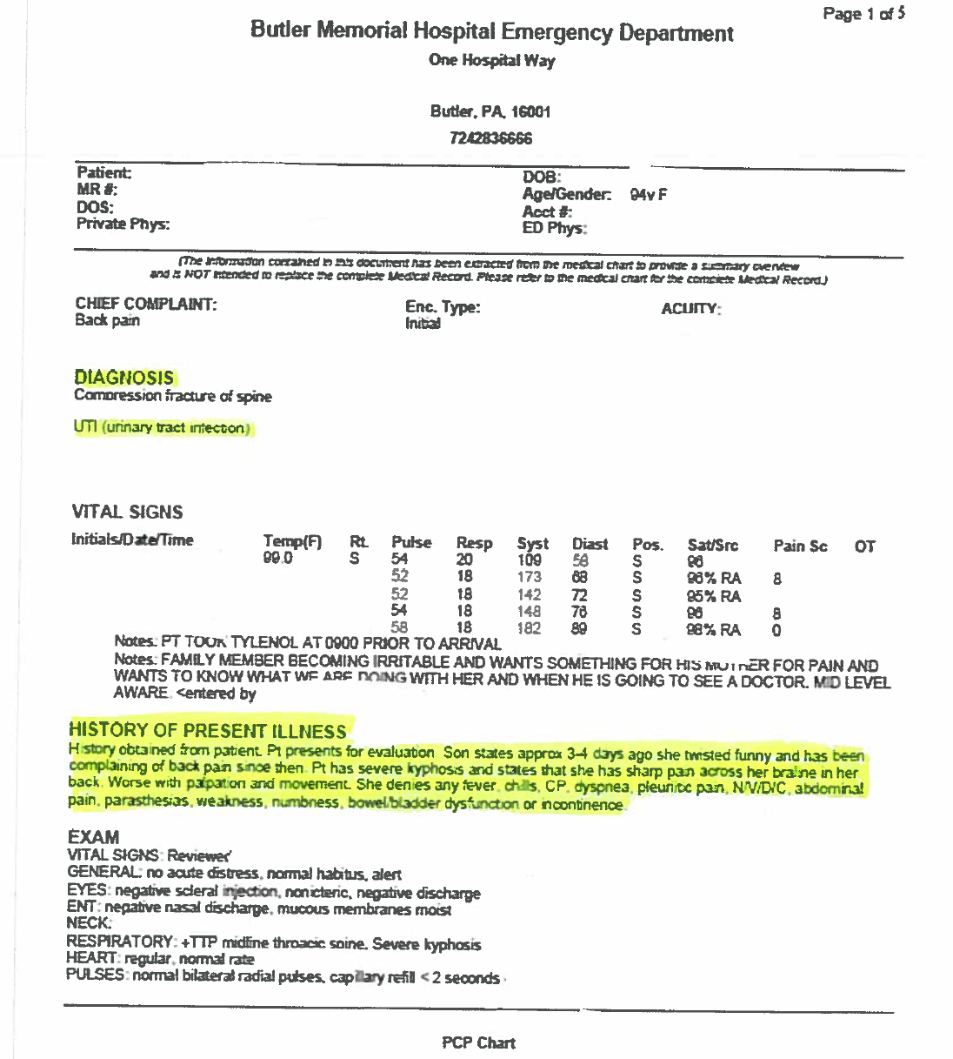
Clinical Vignette

Slide 9
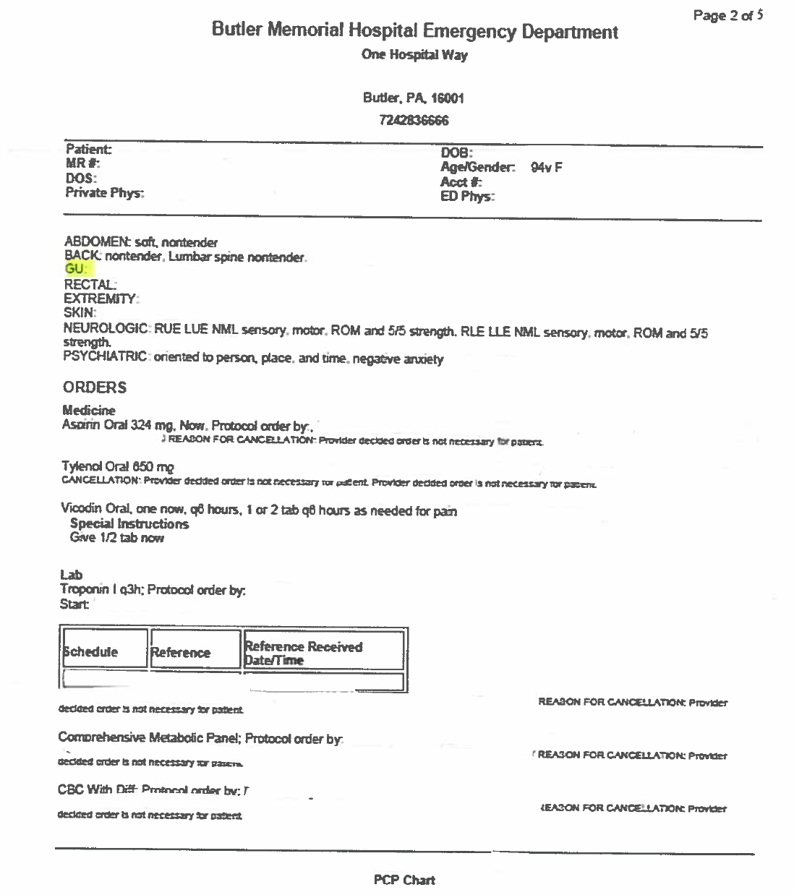
Clinical Vignette

Slide 10
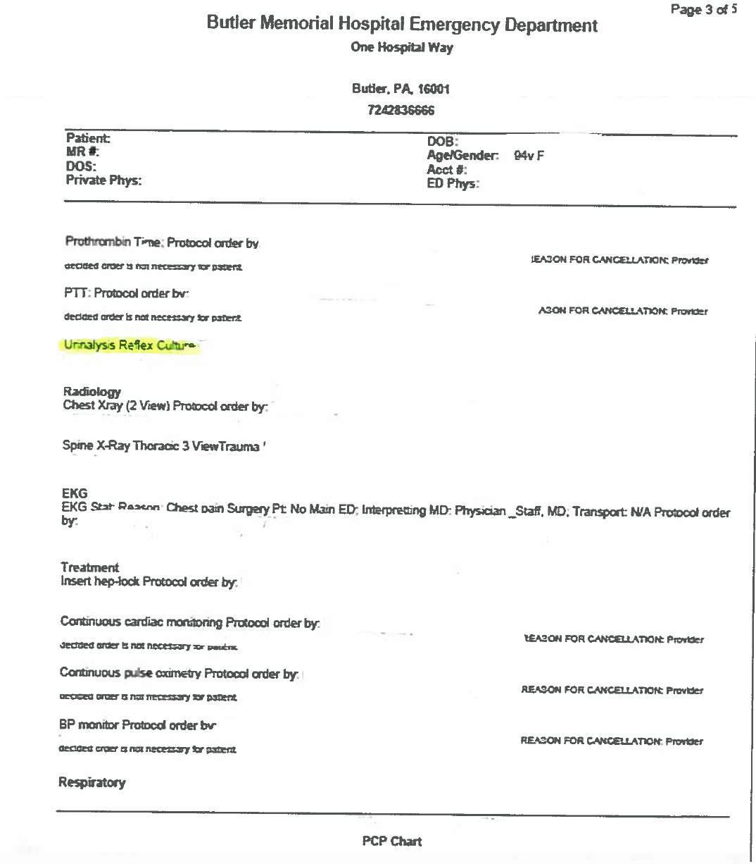
Clinical Vignette

Slide 11
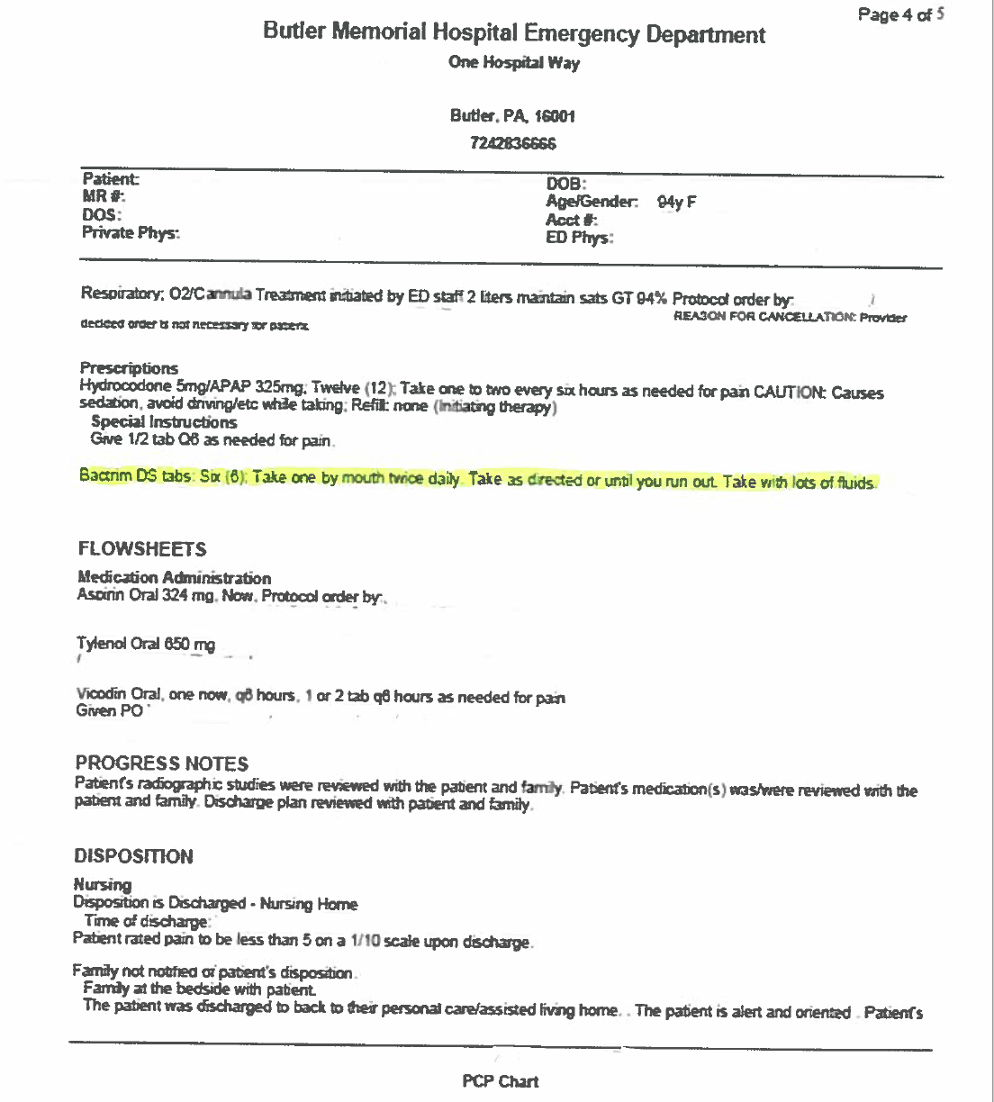
Clinical Vignette

Slide 12
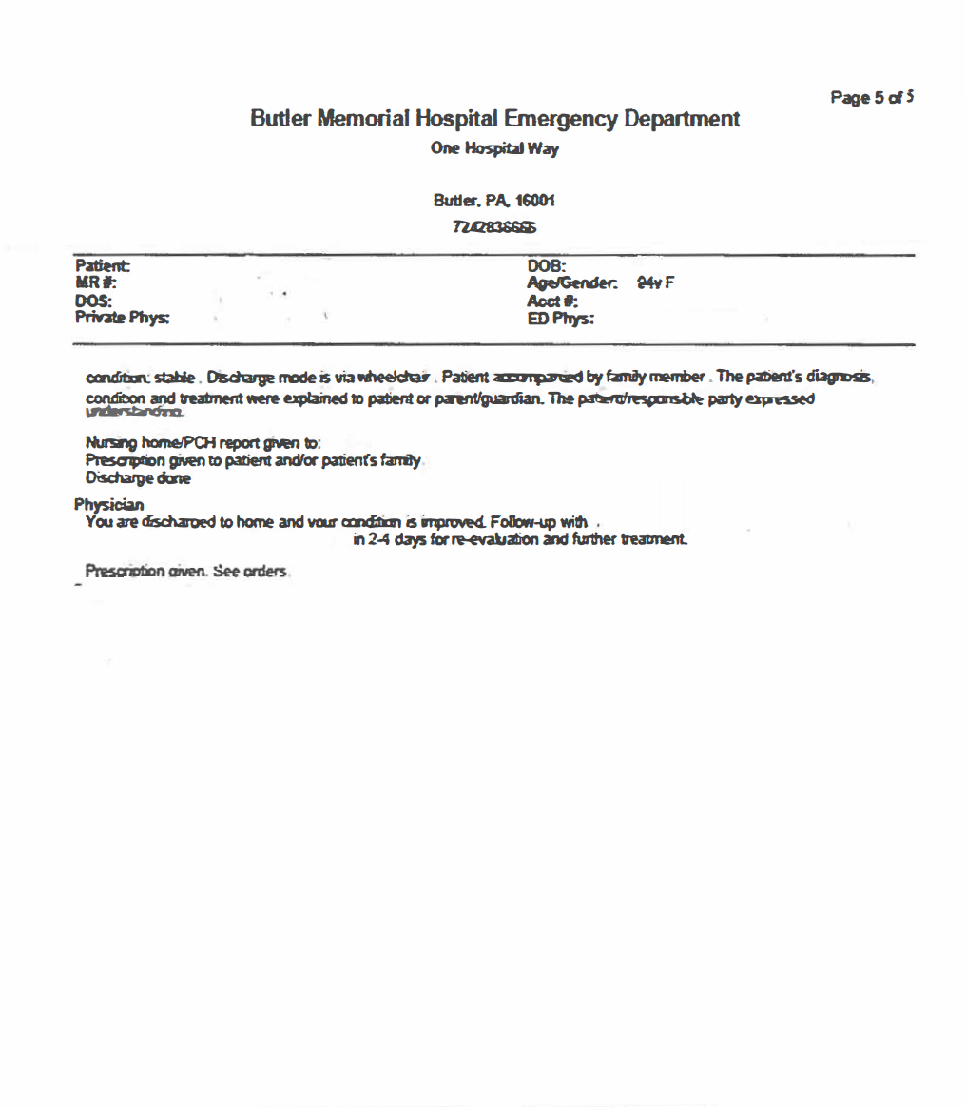
Clinical Vignette

Slide 13
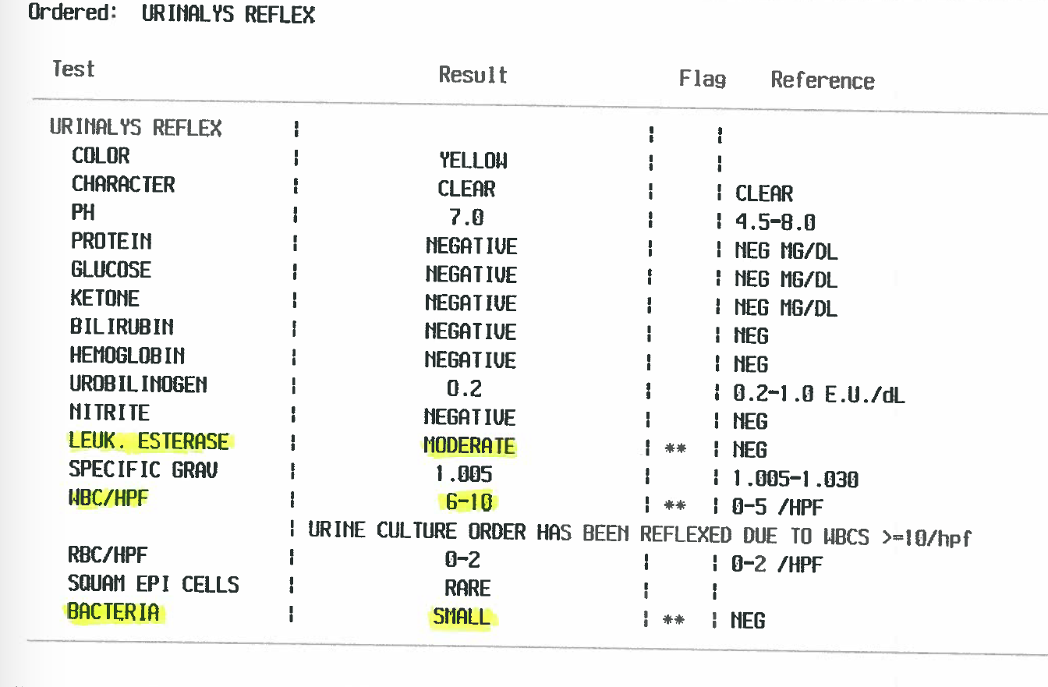
Clinical Vignette

Slide 14
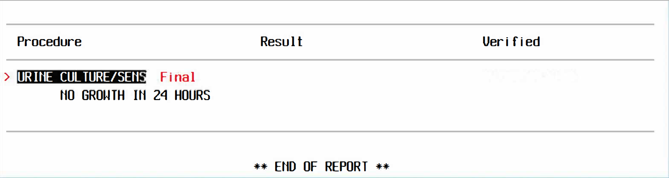
Clinical Vignette

Slide 15
Clinical Vignette Key Factors
The elderly patient in the clinical vignette was diagnosed with a urinary tract infection and prescribed an oral antibiotic upon discharge back to the nursing home.
According to the HPI and physical exam, the patient was negative for any signs or symptoms indicative of a urinary tract infection.
According to the obtained clean catch urinalysis, the patient had asymptomatic bacteriuria, on the basis of pyuria being present and asymptomatic of signs or symptoms indicative of a urinary tract infection.
This patient is a real example of an institutionalized elderly patient with asymptomatic bacteriuria who was inappropriately prescribed an antibiotic.

Slide 16
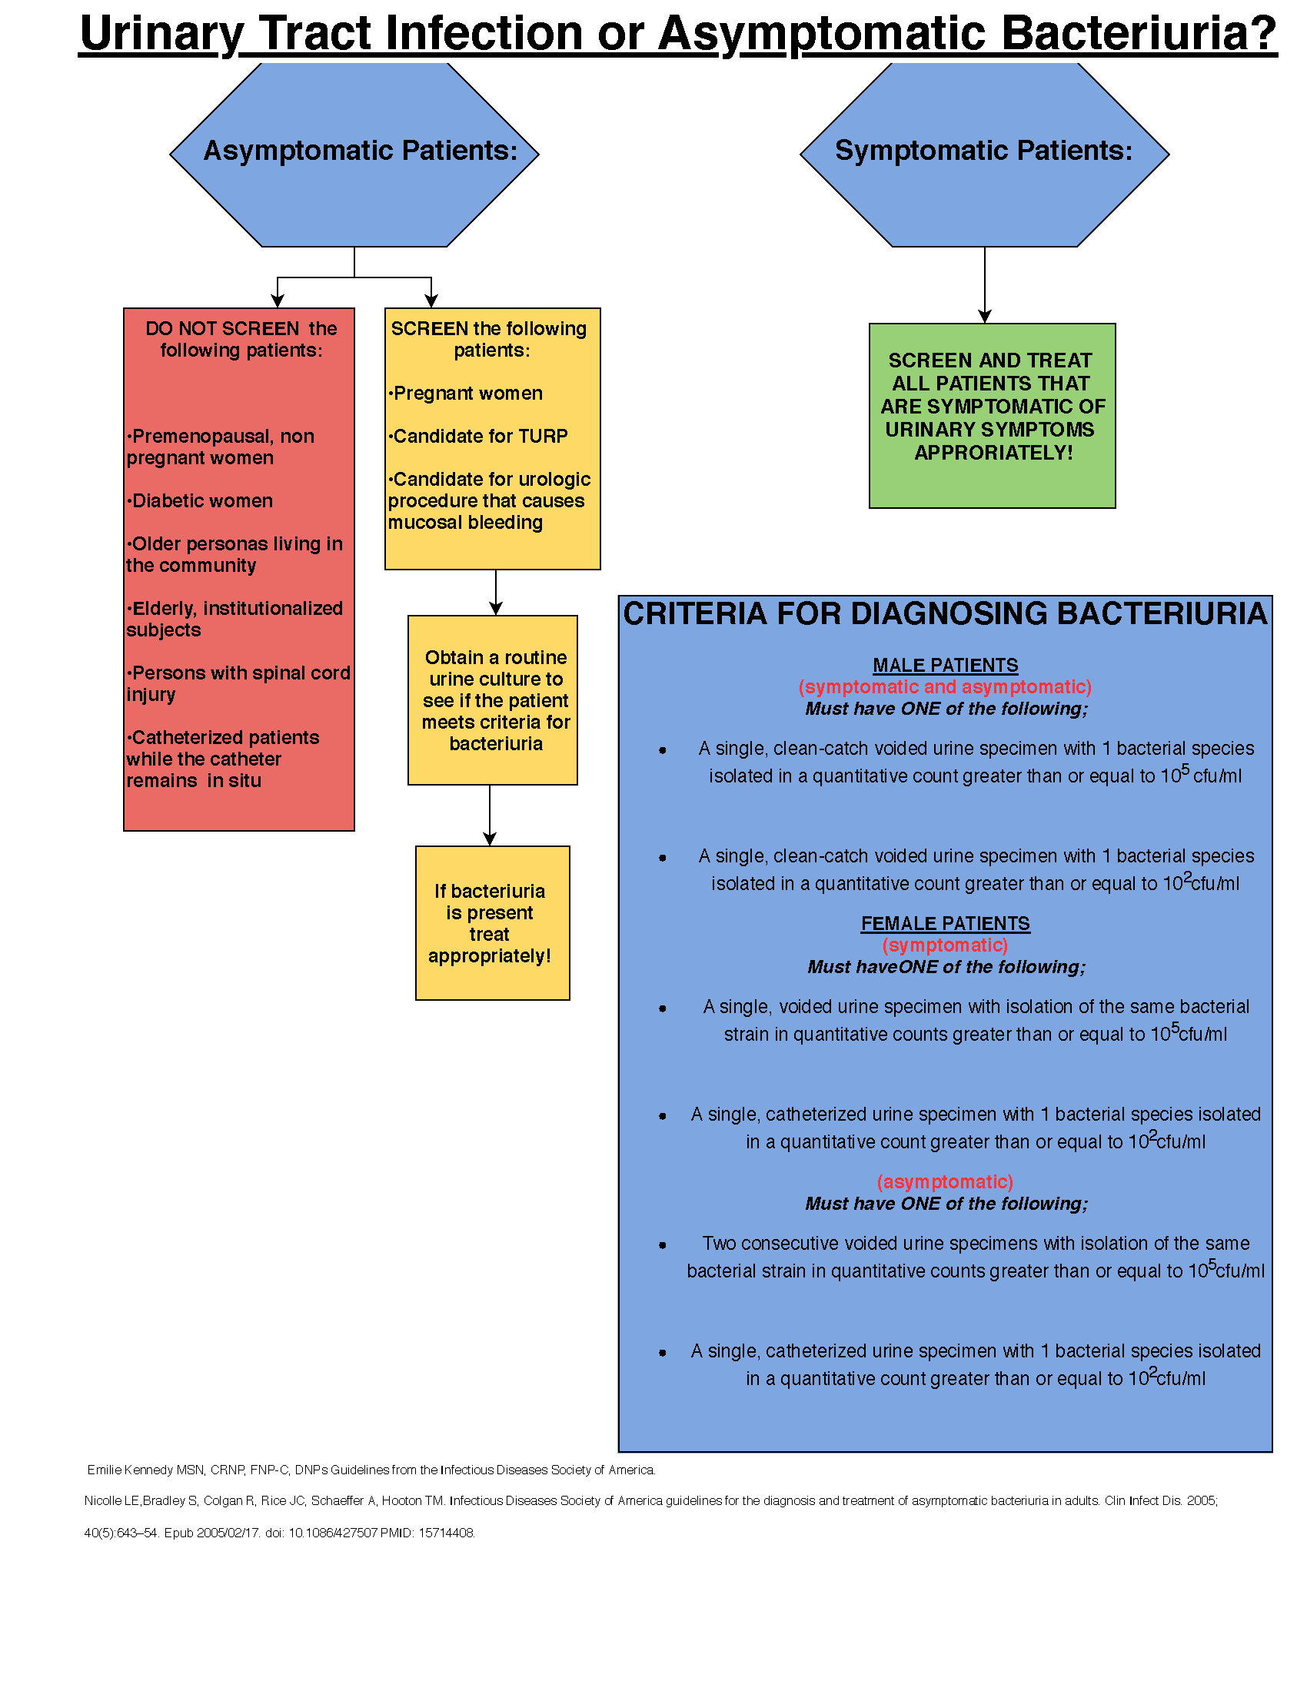
Easy to Follow Algorithm (please take a pocket card)

Slide 17
Thank You!
Please take a pocket card provided!

Slide 18
References
J Community Hosp Intern Med Perspect. 2012; 2(2): 10.3402/jchimp.v2i2.17814.
Published online 2012 Jul 16. doi: 10.3402/jchimp.v2i2.17814
Copyright/License ▼Request permission to reuse
Copyright © 2012 Farhana Chowdhury et al.
Kandel, R., Pallin, D., & Doron, S. Massachusetts Infection Prevention Partnership. Massachusetts Coalition for the Prevention of Medical Errors, Massachusetts Department of Public Health, Massachusetts Senior Care Association, Masspro.
Nicolle LE, Bradley S, Colgan R, Rice JC, Schaeffer A, Hooton TM. Infectious Diseases Society of America guidelines for the diagnosis and treatment of asymptomatic bacteriuria in adults. Clin Infect Dis. 2005; 40(5):643–54. Epub 2005/02/17. doi: 10.1086/427507 PMID: 15714408.

